Slide 1

A Parametric Thoracic Spine Model Accounting for Geometric Variations by Age, Sex, Stature, and Body Mass Index
Authors: Lihan Lian, Michelle Baek, Sunwoo Ma, Monica Jones, Jingwen Hu
May 22nd, 2023

Slide 2



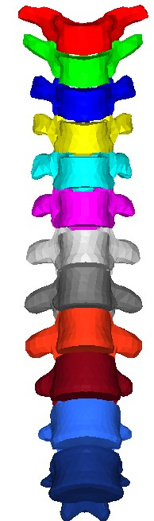
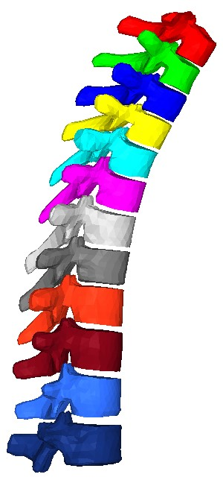
Introduction
Thoracic spine (T-spine) injury prevention will become more challenging
Autonomous driving technology.
Reclined sitting position and seat back.
Literature on T-spine geometry is very limited
No study on morphological variations of T-spine in the diverse population.
Three most important injury mechanisms: compression, distraction, and axial torque.
Source: Drive safely and conveniently from start to finish - https://www.hyundaimotorgroup.com/tech/1075
Notes:
Less focus on Historically T-spine injury is less investigated in occupant protection

Slide 3
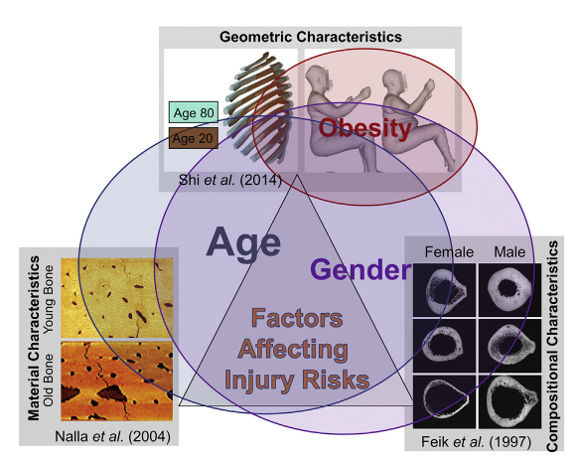
Introduction
Parametric human models are needed for safety equity
Age, stature, BMI and sex are all important factors for risk of injuries.
Small females, elderly, and people with obesity are more vulnerable in motor-vehicle crashes (MVCs) as compared to midsized, young males.
Source: Hu J (2018) "Parametric Human Modeling" Basic Finite Element Method as Applied to Injury Biomechanics, 417-445.

Slide 4
Objective
Develop a statistical thoracic spine model accounting for morphological variations by age, sex, stature, and BMI, based on the data extracted from CT scans.
To the best of our knowledge, this is the first study that a whole T-spine 3D model can accurately predicted for any given age, sex, stature, and BMI. Our study also revealed the statistical significance of each subject covariate.
This model could serve as the geometric basis for parametric human modeling for better assessing T-spine injuries and other pathological analysis.
Source: Hu J (2018) "Parametric Human Modeling" Basic Finite Element Method as Applied to Injury Biomechanics, 417-445.

Slide 5
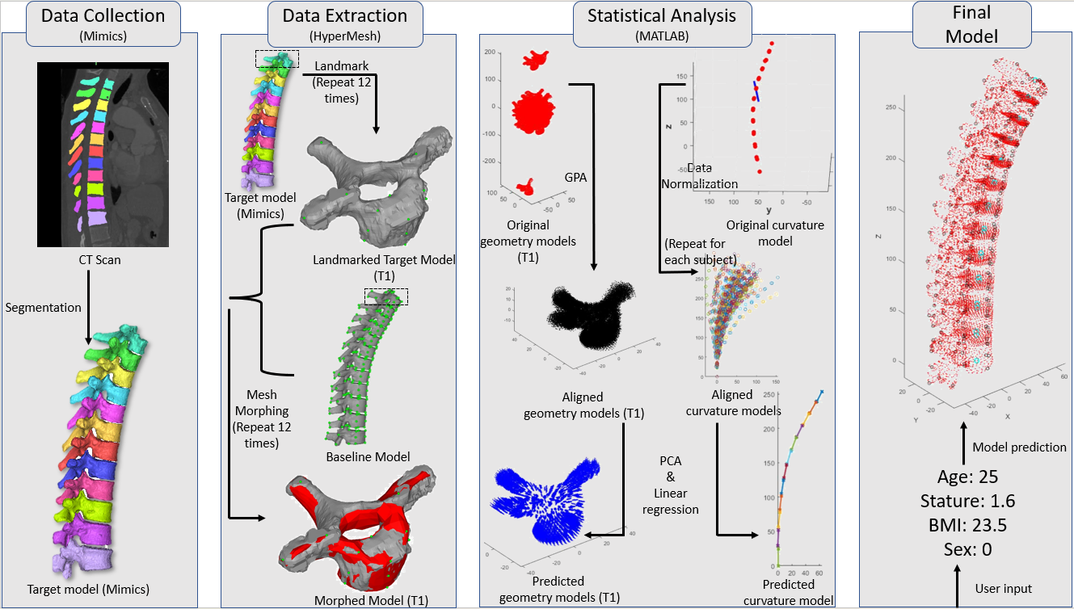
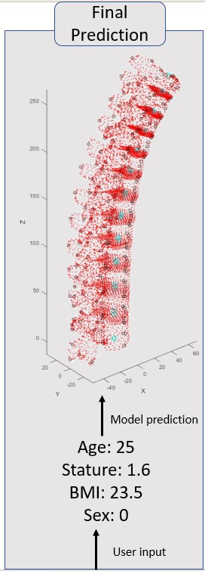
Methods : Overview
Data collection
Data extraction
Statistical analysis
Final prediction
Notes:
T-spine geometry complexity

Slide 6
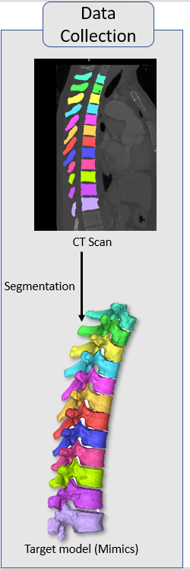
Methods : Data Collection
Data collection
Total of 84 subjects & subject distribution.
Use Mimics to semi-automatically extract T-spine 3D geometry from CT scan and output STL files.
Purpose
Provide non-standard raw data.
Output STL files are used to process in HyperMesh.
Notes:
CT scan manual work from student team

Slide 7
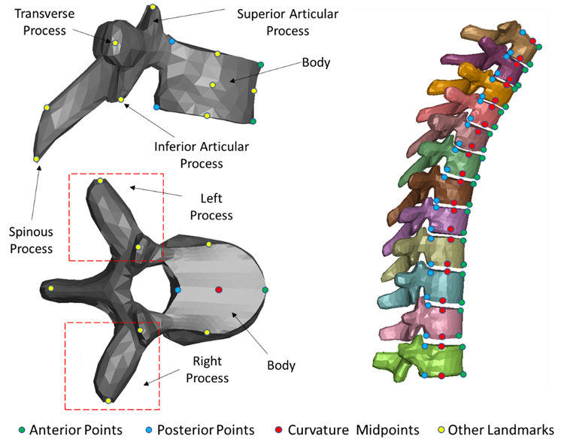
Methods : Data Extraction
Data extraction
Use a standard model as baseline and landmarked model as target.
Morph from baseline model to target model.
Purpose
Make geometry of morphed model as close as possible to target model.
Standardize the data for statistical analysis.

Slide 8
Methods : Statistical Analysis
Statistical analysis – geometry model for each vertebra (T1 to T12)
Generalized-Procrustes-analysis (GPA).
Principal Component analysis (PCA)
Linear regression.
Statistical analysis – curvature model
Data normalization.
Principle Component analysis (PCA).
Linear regression.
Notes:
Gpa: sam location and orientation
PCA: purpose
Liner regression:

Slide 9
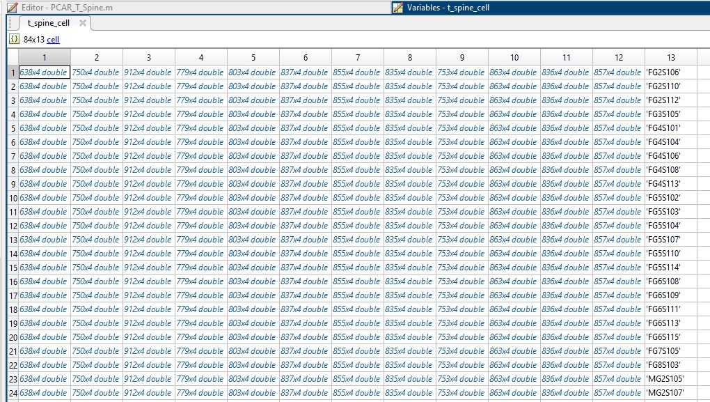
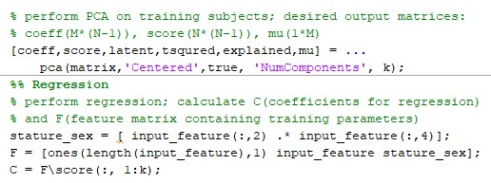
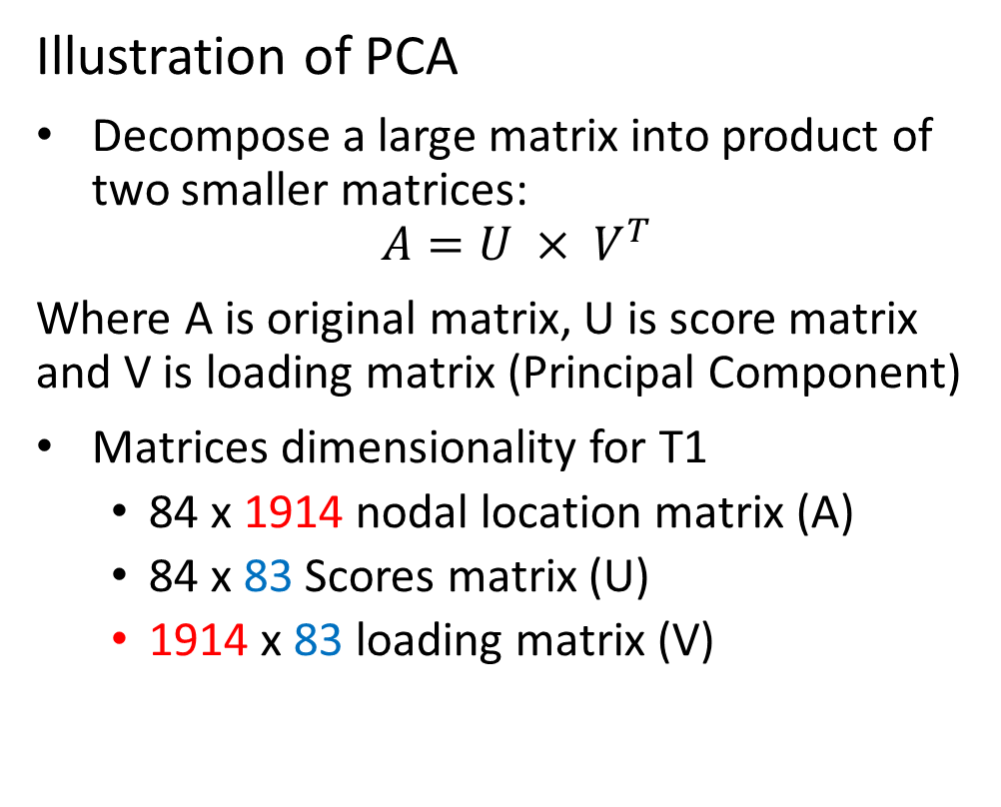
Methods : PCA
# of nodes
Nodal ID, x, y, z
Illustration of PCA
Decompose a large matrix into product of two smaller matrices:
$$A=U × V^{T}$$
Where A is original matrix, U is score matrix and V is loading matrix (Principal Component)
Matrices dimensionality for T1
84 x 1914 nodal location matrix (A)
84 x 83 Scores matrix (U)
1914 x 83 loading matrix (V)
Can select at most 83 PCs (in this case of 84 subjects).
Notes:
Reduce dimension (from 1914 -> 83)

Slide 10
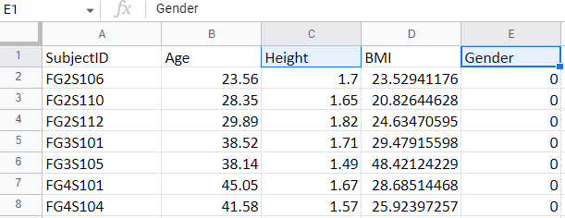
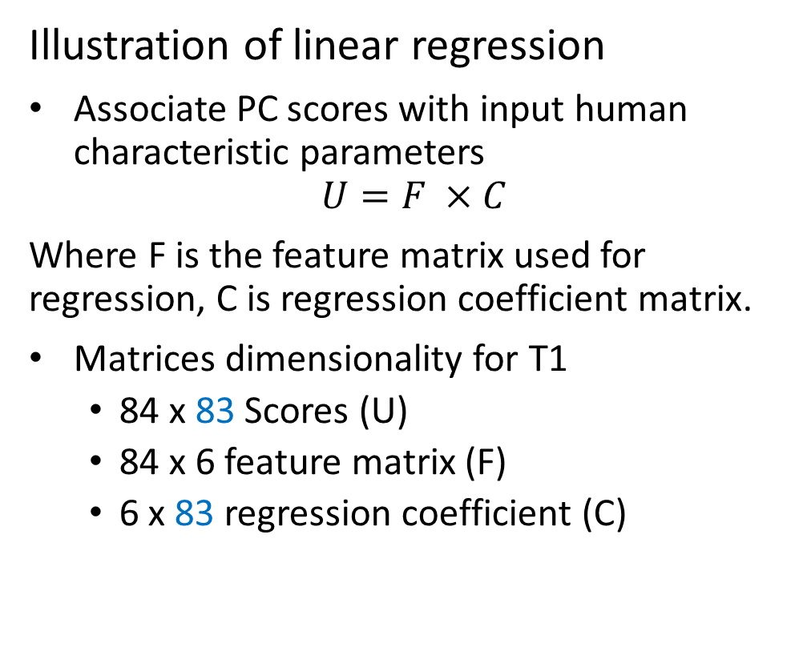
Methods : Linear Regression
Illustration of linear regression
Associate PC scores with input human characteristic parameters
$$U=F ×C$$
Where F is the feature matrix used for regression, C is regression coefficient matrix.
Matrices dimensionality for T1
84 x 83 Scores (U)
84 x 6 feature matrix (F)
6 x 83 regression coefficient (C)
Add intersection for regression
Add due to correlation between two parameters

Slide 11
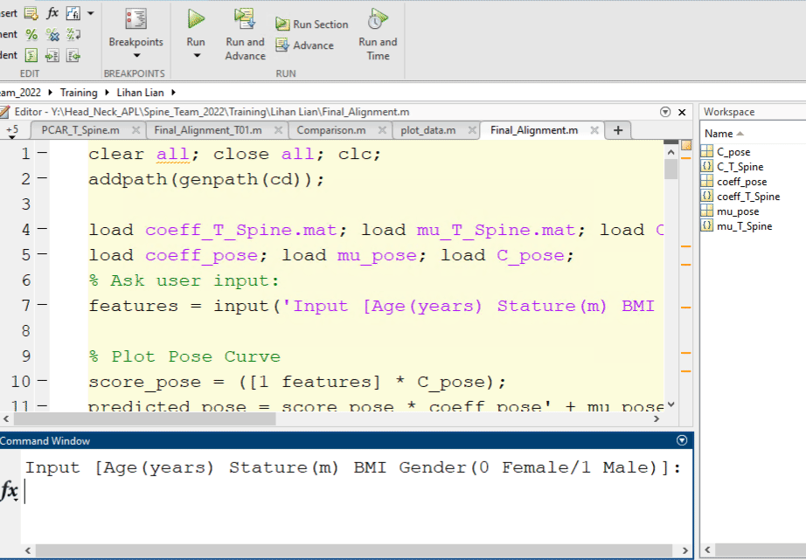
Methods : Final Prediction
MATLAB demonstration
Repeat 12 times and align each vertebra to their corresponding position.
Can also see the necking effect in the predicted model.
Notes:
Emphsize input parameters 13 models

Slide 12
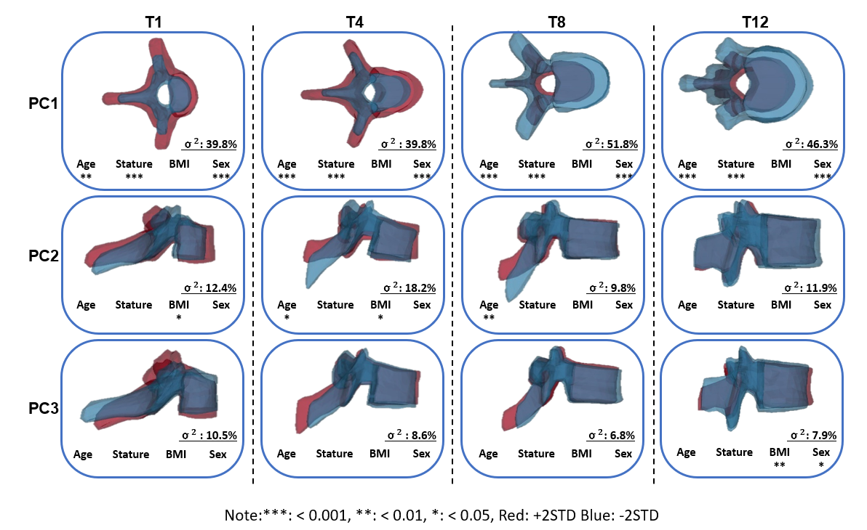
Results : PC Variation
Statistical T-spine model
PC1 accounts for the overall size variation.
PC2 and PC3 accounts for the angle variation.
Notes:
Impact of sex bmi age, stature, (consistently significant for pc1)

Slide 13
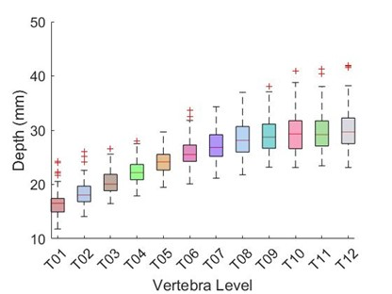
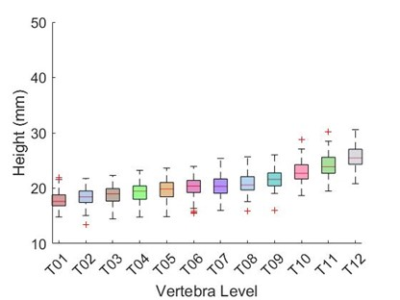
Results : Vertebral Body Dimension
Vertebral body dimension variation trend
Vertebral height and depth strictly increase from T1 to T12.

Slide 14
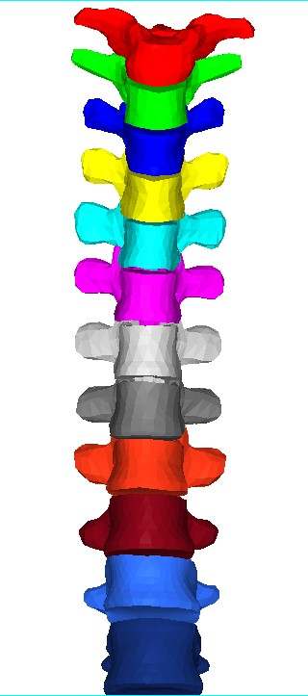
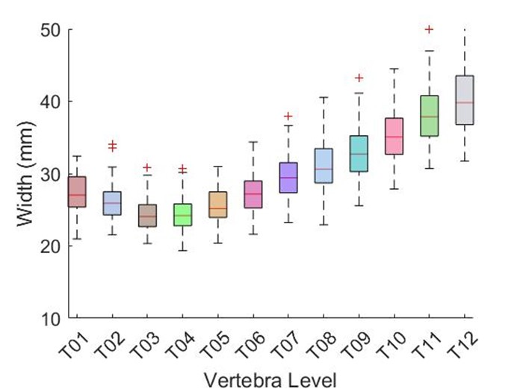
Results : Vertebral Body Dimension
Vertebral body dimension variation trend
Width decreases from T1 to T3, and start increases from T4 to T12 (Necking effect)
Necking region

Slide 15
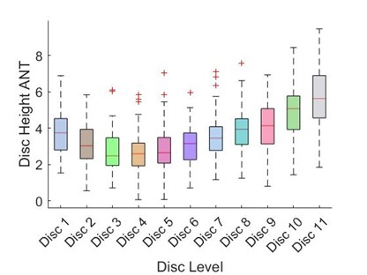
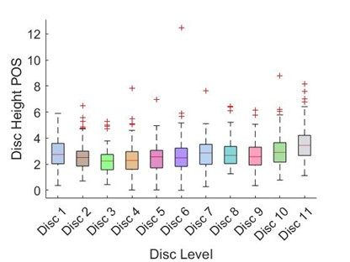
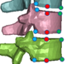
Results : Vertebral Body Dimension
Disc Height
Disc height is the gap between the two level of vertebra
Anterior disc height is bigger than posterior disc height
Posterior disc height
Anterior disc height
Notes:
Add figure of measurement

Slide 16
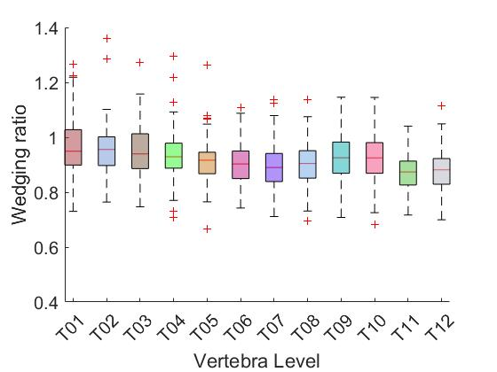
Results : Vertebral Body Dimension
Wedging Ratio
Defined by anterior height divided by posterior height
Posterior height
Anterior height

Slide 17
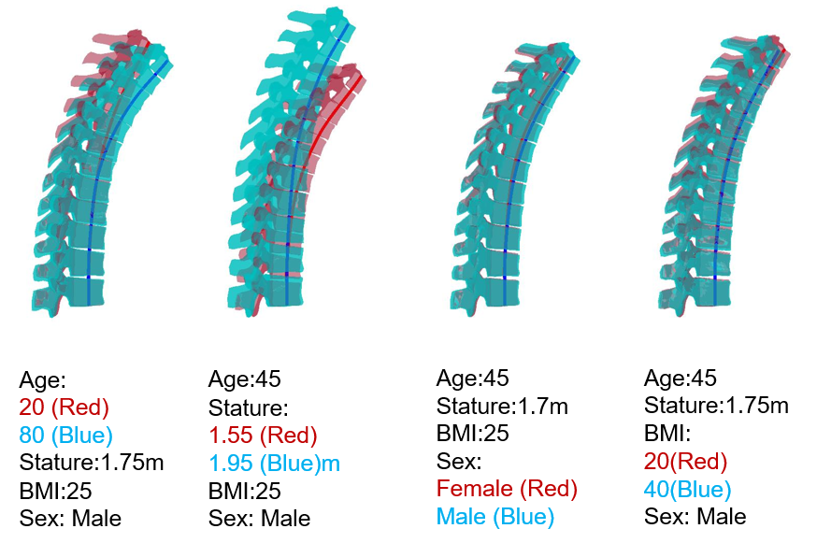
Results : Subject Covariate Effects
Effect of different parameters
Age has big impact on curvature
Stature has big impact on length
Male has larger vertebral size than female
BMI has relatively small impact

Slide 18
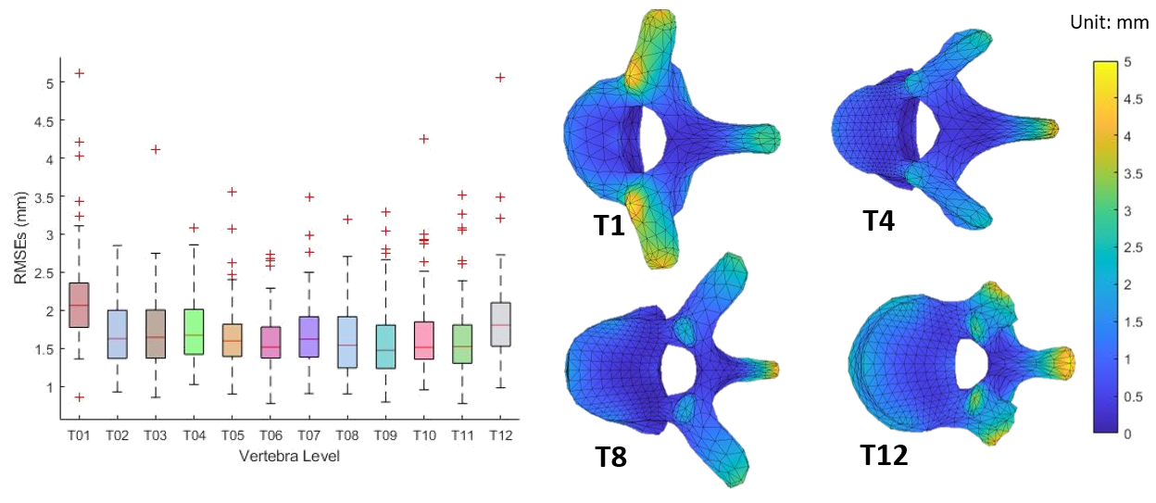
Results : Model Validation
Model error analysis
Leave one out cross validation
Nodal location error
Accurate & Robust
Notes:
Less than 2 mm is much smaller than the variation presented in the vertebral geometry, and the FE size are typically 5mm for human models. (How does the model prediction performance look like?)

Slide 19
Discussion
Develop a statistical model that can accurately predict a full T-spine model given a set of characteristic parameters.
Analyze the variation trend of width, height, and depth from T1 to T12 and find the necking effect.
Demonstrate the effect of different parameters through comparison.
In this study, all CT scans were collected while subjects were in a supine position. Therefore, the curvature model developed in this study may not be appropriate for representing other postures. The landmarking process was finished by a single person manually and followed by another person checking the landmarking quality. This may potentially introduce errors related to landmark positioning and subsequently impact the morphing results.
Notes:
Limitation:

Slide 20
Conclusion
Develop a statistical model that can accurately predict a full T-spine model given a set of characteristic parameters.
Analyze the variation trend of width, height, and depth from T1 to T12 and find the necking effect.
Demonstrate the effect of different parameters through comparison.
We plan to turn this study into a peer-reviewed journal publication this summer.

Slide 21
Acknowledgement
The authors would like to thank Anne Bonifas from UMTRI for her support on CT acquisition and segmentation.
The authors would also like to thank the students from the Multidisciplinary Design Program (MDP) at the University of Michigan for their support of the study.
Notes:
Combinate next slide. A few sentence from paper

Slide 22
Thank you ! Any questions ?
Checkout appendix for more detailed explanation

Slide 23
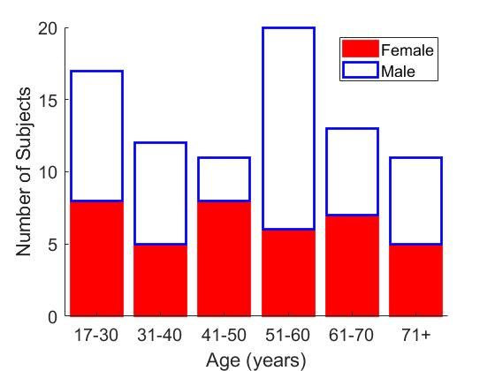
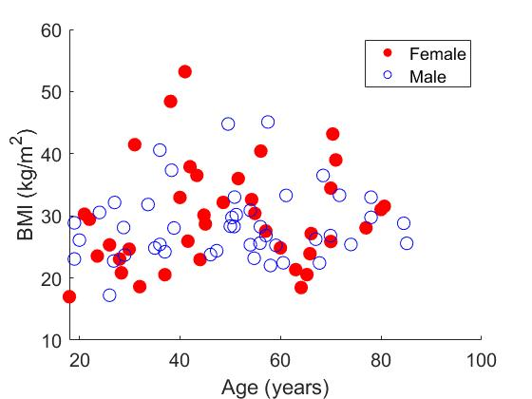
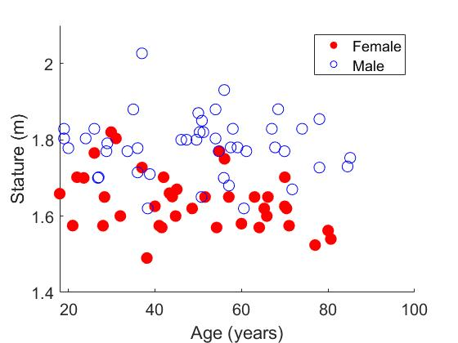
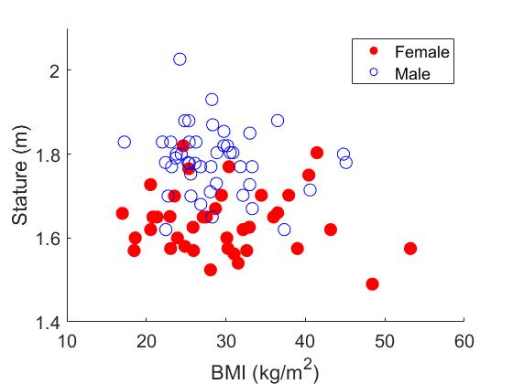
Appendix
Distribution of subjects that used for the study.

Slide 24
Appendix
Landmark and curvature model definition.
Landmark definition
Each vertebra has 19 landmarks.
Curvature definition
Use midpoints (color in red) for curvature model, each vertebra has two midpoints

Slide 25
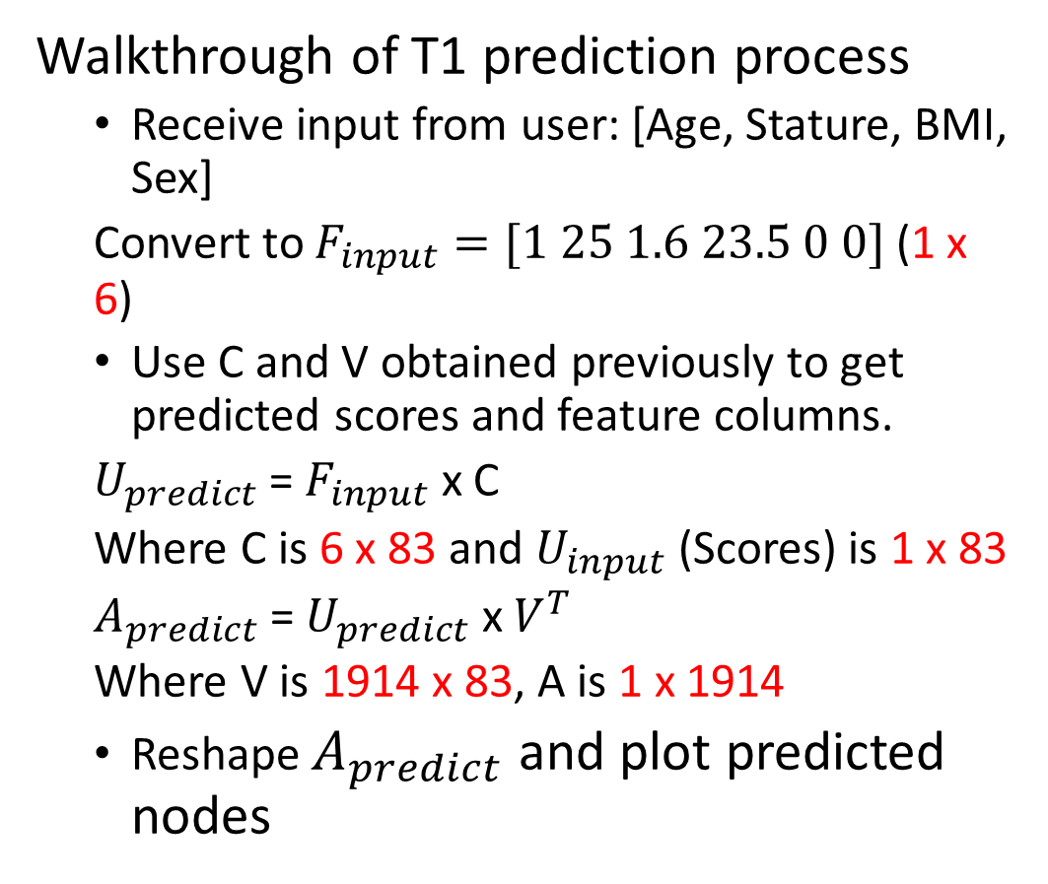
Appendix
Walkthrough of T1 prediction process
Receive input from user: [Age, Stature, BMI, Sex]
Convert to $F_{input}=[1 25 1.6 23.5 0 0]$ (1 x 6)
Use C and V obtained previously to get predicted scores and feature columns.
$U_{predict}$ = $F_{input}$ x C
Where C is 6 x 83 and $U_{input}$ (Scores) is 1 x 83
$A_{predict}$ = $U_{predict}$ x $V^{T}$
Where V is 1914 x 83, A is 1 x 1914
Reshape $A_{predict}$ and plot predicted nodes

Slide 26
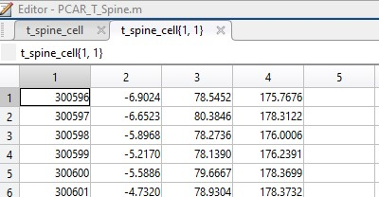
Appendix
Content inside nodal location matrix that used for statistical analysis

